Slide 1
British Airways Customer Booking Prediction Model
Forage Task 2

Slide 2
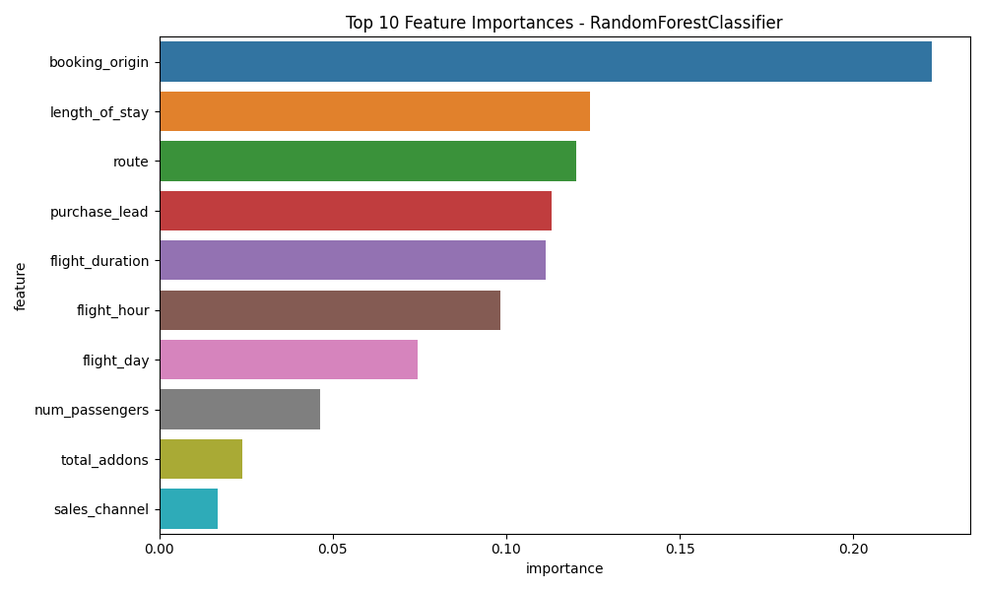
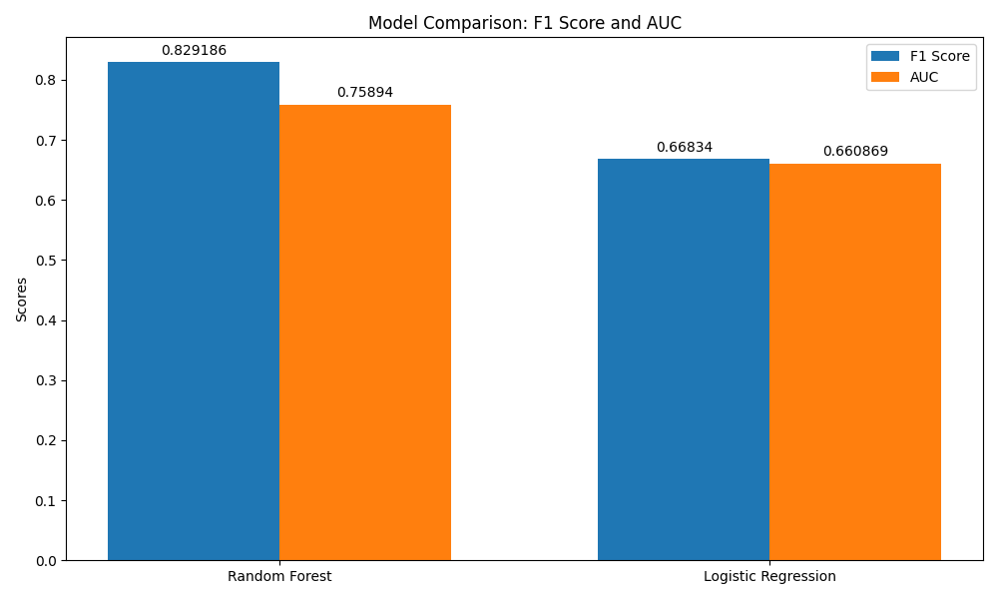
Key insights:
Random Forest outperformed Logistic Regression. Good overall performance, but room for improvement.
Geographic and trip-specific factors are most predictive
Customer preferences (e.g., add-ons) less impactful than expected
Time-related features (lead time, stay length, flight time) play significant roles
Weekend vs. weekday travel has minimal impact on booking likelihood
Business Implications:
Focus marketing efforts on high-converting booking origins
Tailor offers based on trip duration and route
Optimize pricing and promotions for different purchase lead times
Consider flight duration in package deals and pricing strategies

